Slide 1

Tech Store App
Vinicius Rodrigues
Kylie Beck
Gunnar Grispino

Slide 2
Features
Used 2 Collection Views
Collection view to show the Product Catalog of our store
Every cell has image, name, and price of the product
Collection view to show the products the user adds to the Cart
Every cell has image, name, price, and quantity of the product
Used Segmented Controls to give related options to user
Login or Signup, Delivery or Pickup, and Payment Methods
Used a Picker View
User scrolls to choose his preferred pickup location
Tech Store App has 4 locations (Maryville, St. Joseph, Kansas City, and St. Louis)

Slide 3
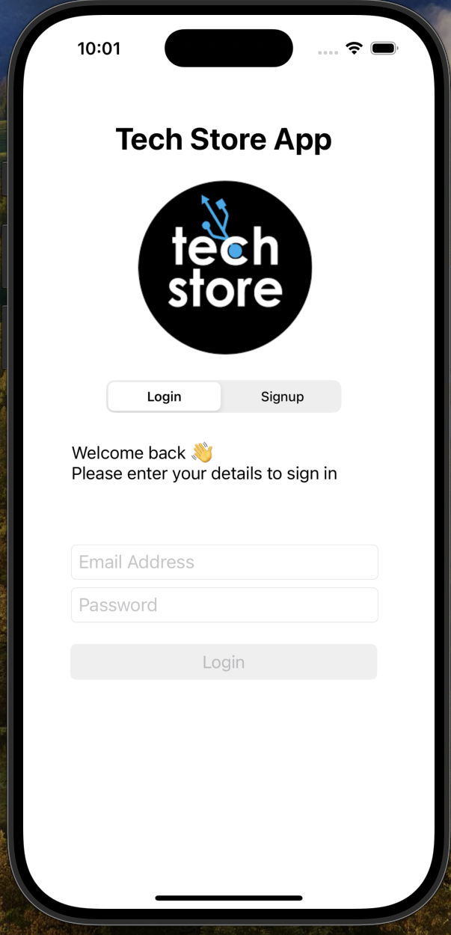
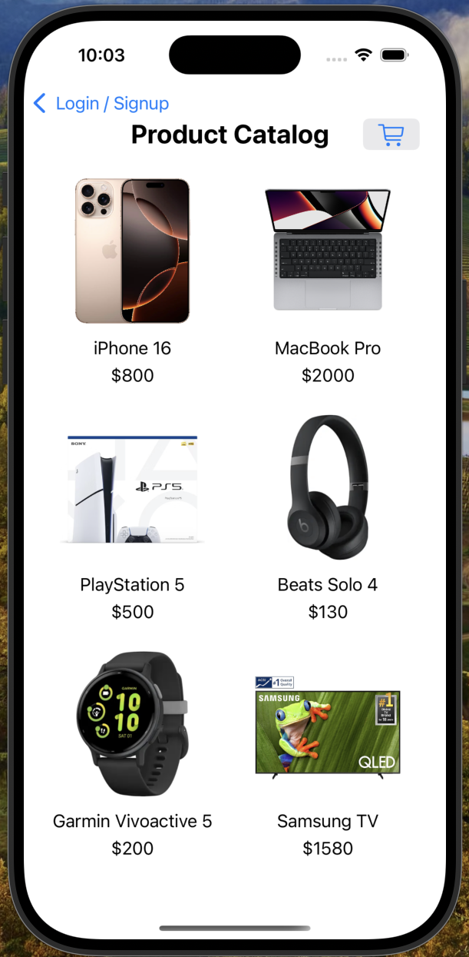
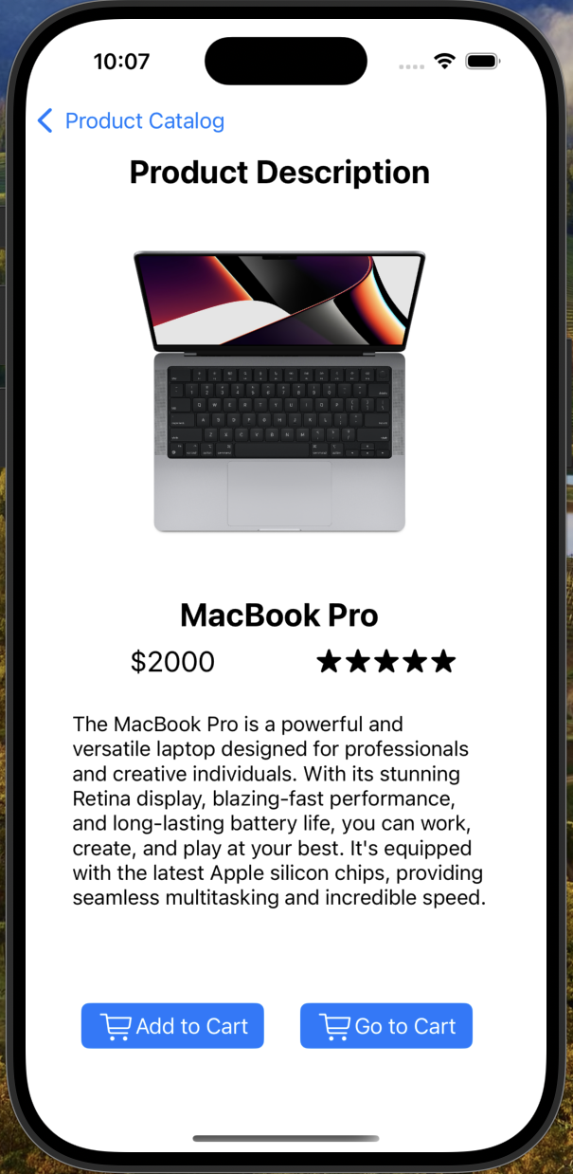
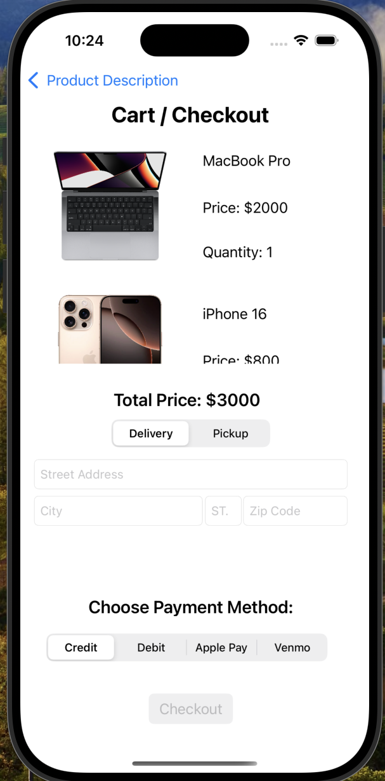
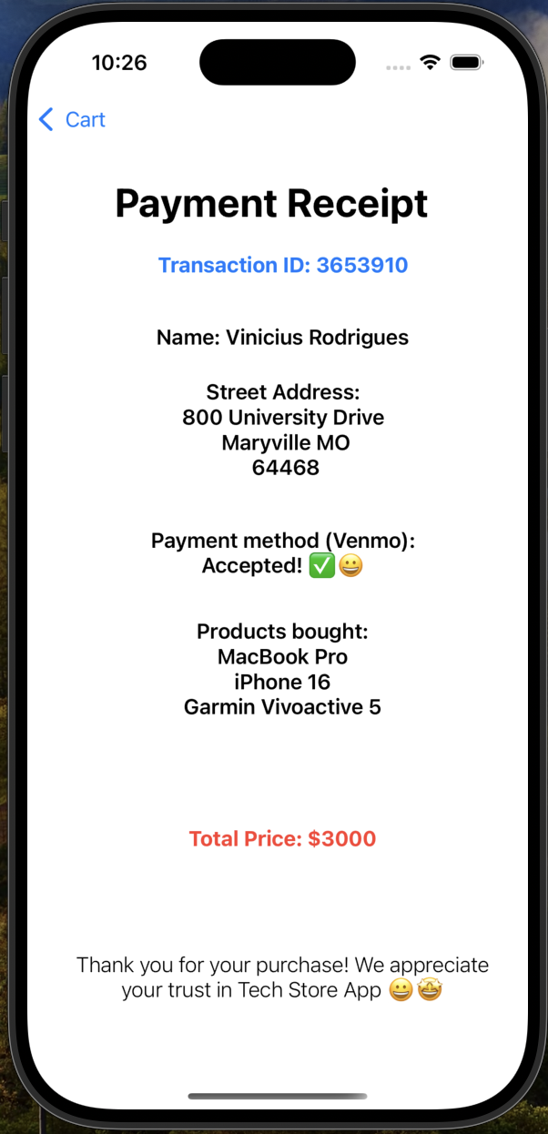
Demonstration

Slide 4
Thanks for watching our presentation!! 😃😃

